Slide 1

Bruno Layus
brunolayus@gmail.com
brunolayus.github.io
github.com/BLayus
linkedin.com/in/brunolayus
2024 April
Data Science Case Study - Pizza Restaurant
ACADIA.IO

Slide 2
This section aims to produce answers for questions about the customers habits and patterns. What are the most probable things that lead a client to return?
And what are the main characteristics that differentiates a group of customers which made more than one visit compared to the ones that did not visit the store more than once?
What are the possible actionable ideas that can convert more in terms of effectiveness customer retention?
1 - Exploratory Data Analysis

Slide 3
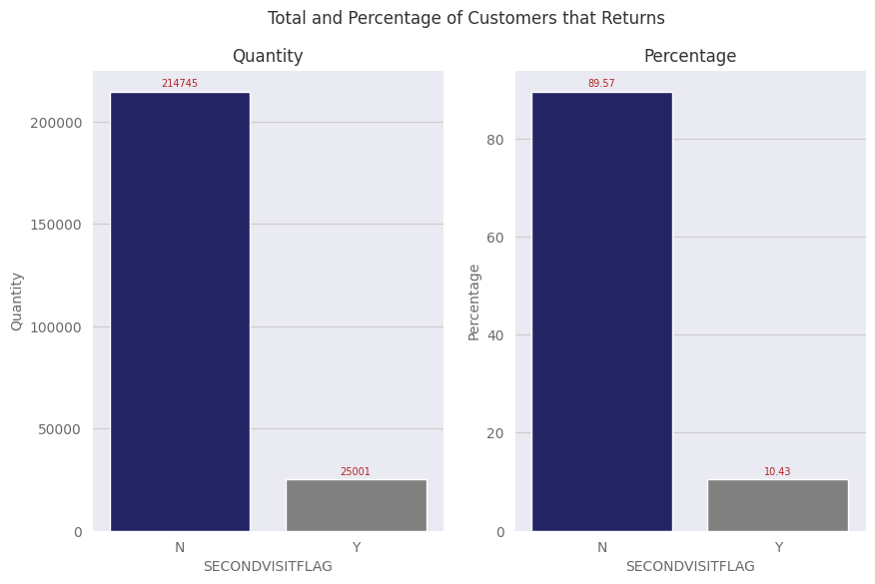
This chart demonstrates how many customers had returned to the stores .
In blue there are customers who did not returned.
In gray there are customers who did returned.
As shown, this dataset has a predominant class and this lead us to a non balanced classification problem. The model will try to predict what are the probabilities of a given customer to return or not to one of the chain stores.
Approximately 10% of the clients returns to one of the stores.

Slide 4
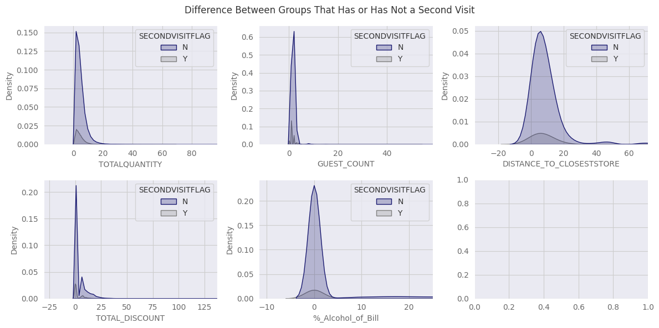
Distribution of features not directly related to food orders.
Shows only a quarter of the values to better visualize the distribution curves, this way we can compare what kind of feature has different behaviors between customers that did return and the ones that did not return to restaurants.

Slide 5
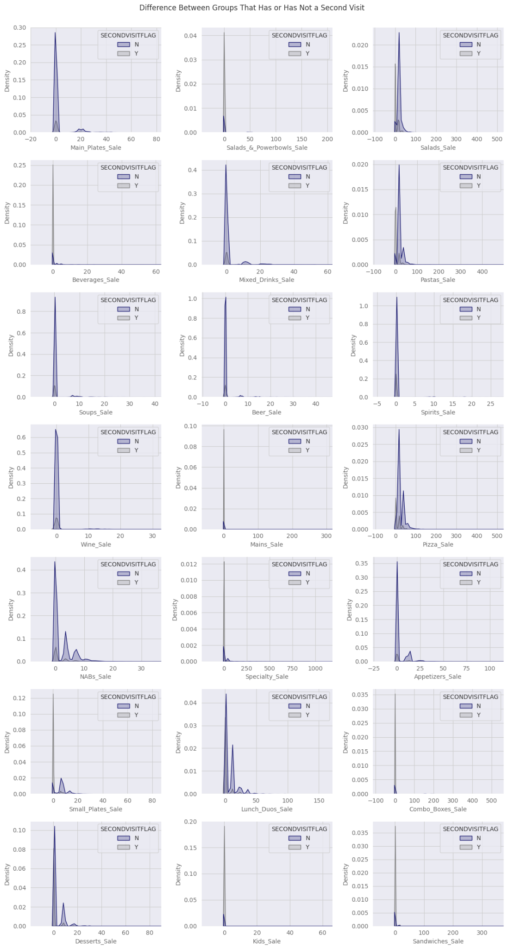
Distribution of features related to food orders.
Shows only a quarter of the values to better visualize the distribution curves.
It’s possible to distinguish some features that has greater distributions of clients who returns than others that clients did not return.
What kind of orders are more recurrent in customers group that did return and what are the differences from other kind of orders?
This question can be useful to better understand what are the main factors that brings customers back to the restaurants.

Slide 6
Distribution of features related to food orders.
Shows only a quarter of the values to better visualize the distribution curves.

Slide 7
From the above charts it can be deduced that:
Distance to closest store is a possible factor that brings customers back to stores.
Clients which comes back to stores comes with less guest counts.
Alcohol consumption it's not directly related to customers return, on the contrary, the lower the expenditure on alcohol, the more likely the customer will return.
Some kind of orders are more associated with customers that return to the stores, for instance: sandwiches, kids, mains dishes, salads and beverages.
Pizza and pasta are types of orders that stays in the middle term, but has patterns that are clearly different from the others.

Slide 8
In this step, the objective is create new features that can be useful to further modelling:
Create new features with total sum of expenses, total sum of beverage, food and alcoholic drinks expenses.
Create a new feature with total bill (total expenses minus total discount).
Confirm percentage of alcohol consumption to check values in the previous “%_Alcohol_of_Bill”
Some assumptions are also relevant:
This is a CLASSIFICATION machine learning problem, the challenge is to identify correctly between two classes of customers which comes back or not to the restaurants.
Tree based models (appropriate strategy) do not need feature scaling as they can choose to split features independently.
There should be no null values and categorical features must be encoded.
The null values in the feature “DISTANCE_TO_CLOSESTSTORE” were filled with 0, it means that probably there is no other store in the neighborhood / city.
2 - Feature Engineering

Slide 9
In this section, some ML models are going to be tested in the dataset, their metrics will be explained and evaluated and, at the end, the best model will be chosen. Four different models based on decision tree were applied:
1 - Decision Tree Model - The model learns from data by identifying patterns and creating splits at the nodes that best differentiate the data points.
2 - Random Forest - It’s an ensemble method that uses several decision trees and bootstrap samples to predict target with a better overall result.
3 - XGBoost - It’s an ensemble of gradient boosting decision trees which uses several trees to choose best split for each node. It uses the concept of gradient learning from the previous trees to improve prediction.
4 - LGBM - It’s an ensemble similar to XGBoost, that uses trees and gradient boosting to split the nodes, but faster and much more computationally efficient.
3 - Machine Learning Models

Slide 10
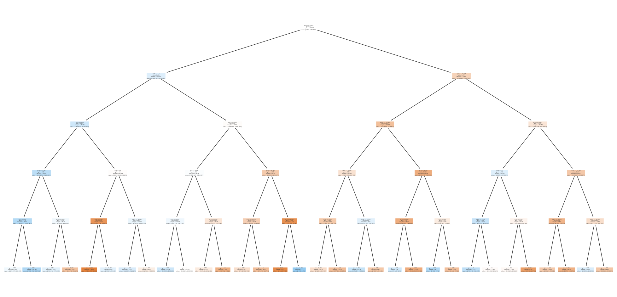
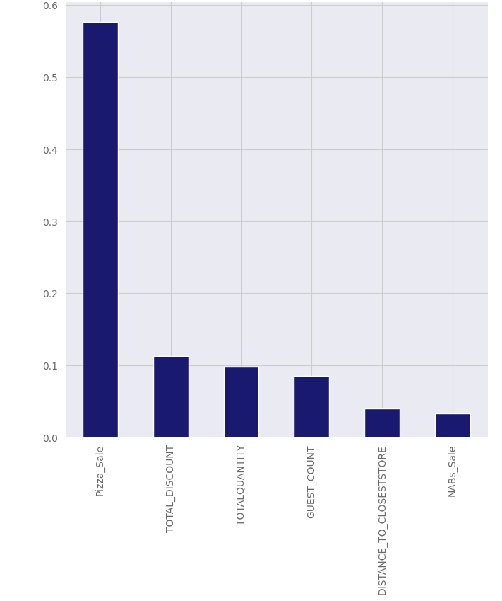
Decision Tree
This chart shows the inner mechanics of the algorithm, it works by splitting a node in the most different subset from the previous one.
The second chart shows the feature importances considered for this tree. We can see that “Pizza_sales” and “Total_Discount” are the two most important characteristics that can differentiate each customers tendency to return to the restaurant.

Slide 11
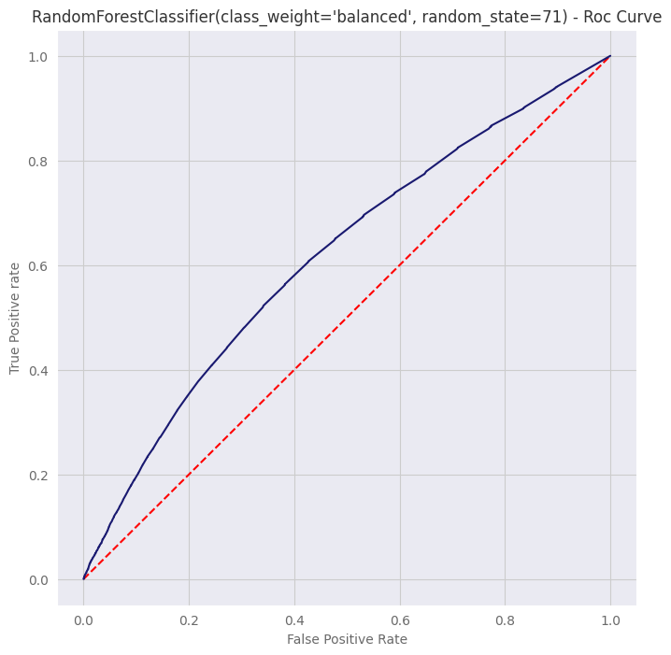
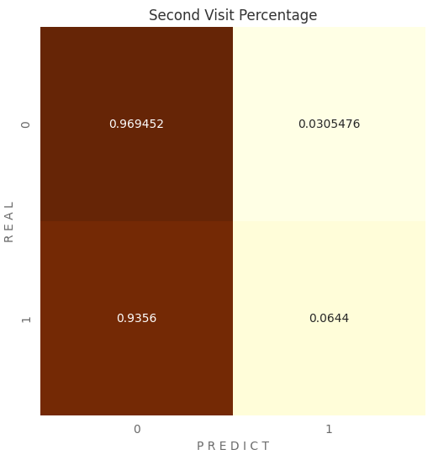
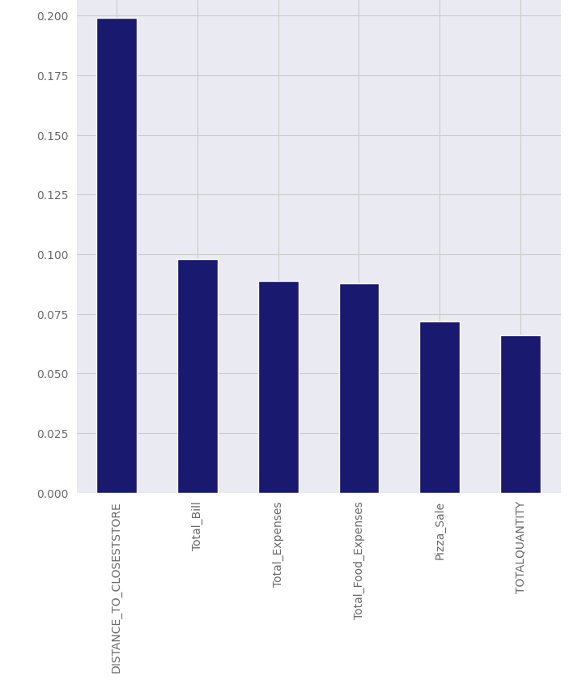
Random Forest
The first chart is the ROC AUC Curve, the interpretation of this chart is quite simple: the red dashed line indicates a 50% probability of classification. The most to the top left the blue curve is, the better the ability to distinguish between the classes.
The second chart is a confusion matrix and it also shows the poor generalization capacity of this model, as it overfits on the predominant class.
The third chart displays the feature importances that were taken into consideration for this model. It chooses distance to the closest store as the most important predictor feature.

Slide 12
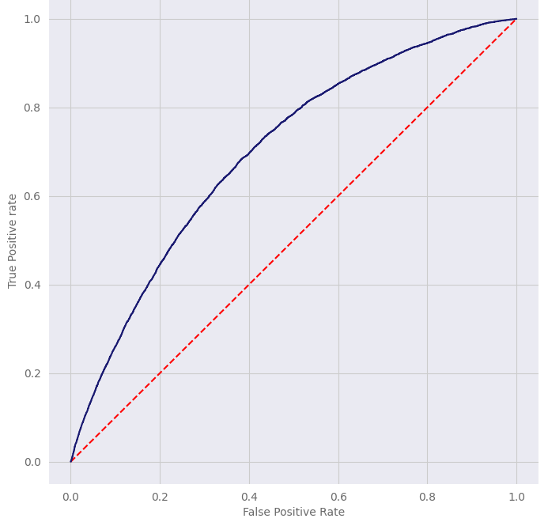
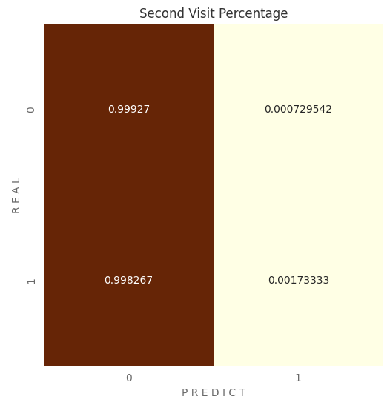
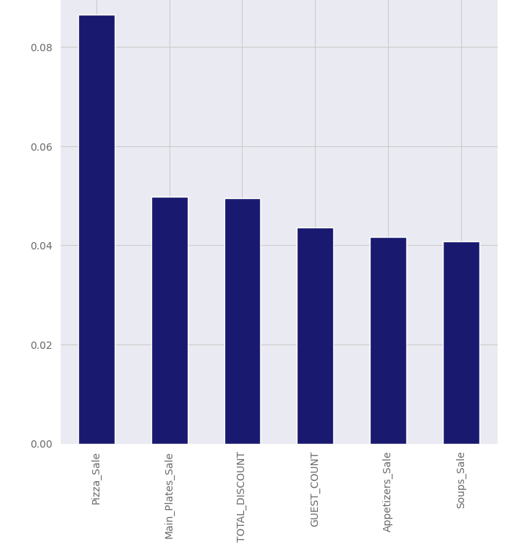
XGBoost
The first chart is the ROC AUC Curve, it’s slightly better than the random forest chart, but still being a poor predictor model.
The second chart displays the confusion matrix and again we can see that the model overfitted in the predominant class, being unable to distinguish the minority class.
The third chart shows feature importances for this model. Again “Pizza Sales” is considered a good predictor feature.

Slide 13
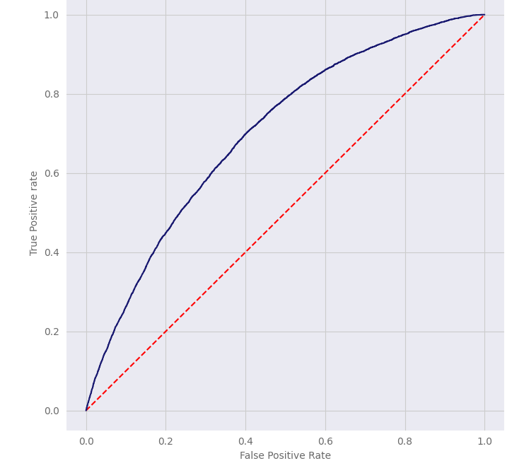
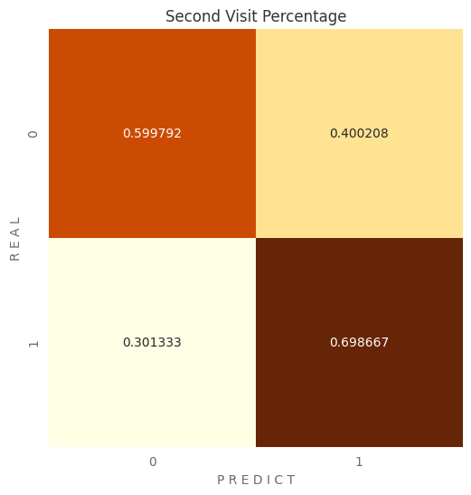
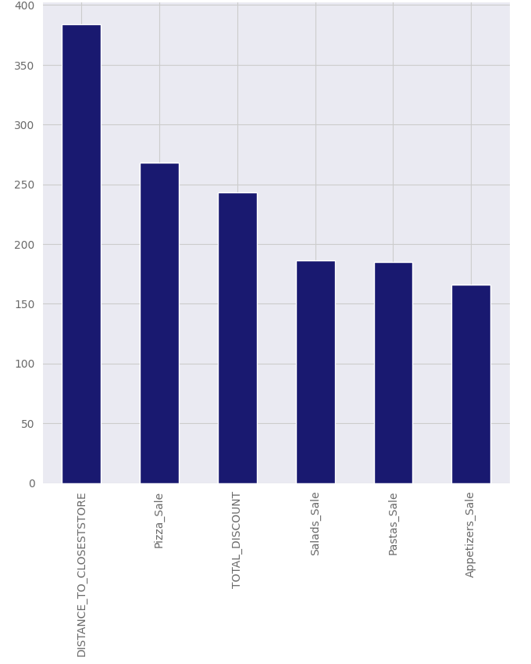
LGBM
The ROC AUC Curve is better than the others, despite not being the ideal. AUC scores around 70% are just acceptable, not excellent.
The confusion matrix doesn’t show overfit anymore, it presents a better balance between majority and minority classes.
Again “Distance to Closest Store” and “Pizza Sales” is considered good predictor features, together with “Total Discount’ and “Salads Sales”.

Slide 14
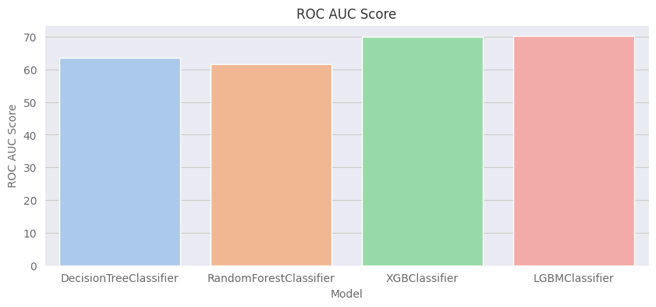
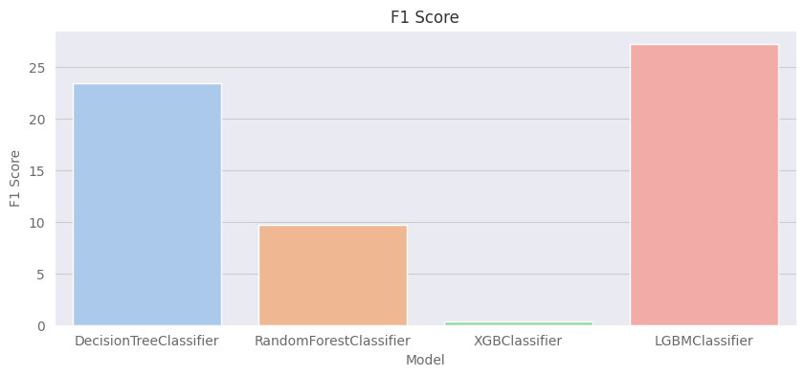
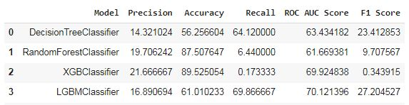
Comparative Metrics
For this problem, an imbalanced classification problem, the balanced metrics like Roc Auc Curve and F1 Score, which
relates the proportions between True and False Positives are good choices to evaluate the effectiveness of the models.
LGBM was the model which presented the best balanced metrics, so it was the best choice to this problem.

Slide 15
Which Model has Better Performance?
LGBM was chosen due to this better metrics and fast implementation.
It is a model that uses a sequence of decision trees, each new tree tries to correct errors and improve the previous ones, gradually improving the model's accuracy.
The model increases its effectiveness by using an optimization based on Gradient Boosting, where machine learning takes place iteratively by training new models to minimize the errors of the previous model. Each subsequent model is then trained to correct the deficiencies of the previous one and thus gradually improve the classification. At the end of the iteration process, the models are powerfully combined based on their effectiveness in minimizing previous errors and choose a final prediction.
LGBM is a fast process that uses relatively few computational resources, being very efficient for models in production, when a quick response from the model is required.
It hits 70% of true positive cases and classifies 30% of false negative cases.
At the same time, it gets 60% of true negative cases right and 40% of false positive cases wrong.
As we can see it's not the best model performance ever, but has balanced metrics and it probably means that the model is reliable.

Slide 16
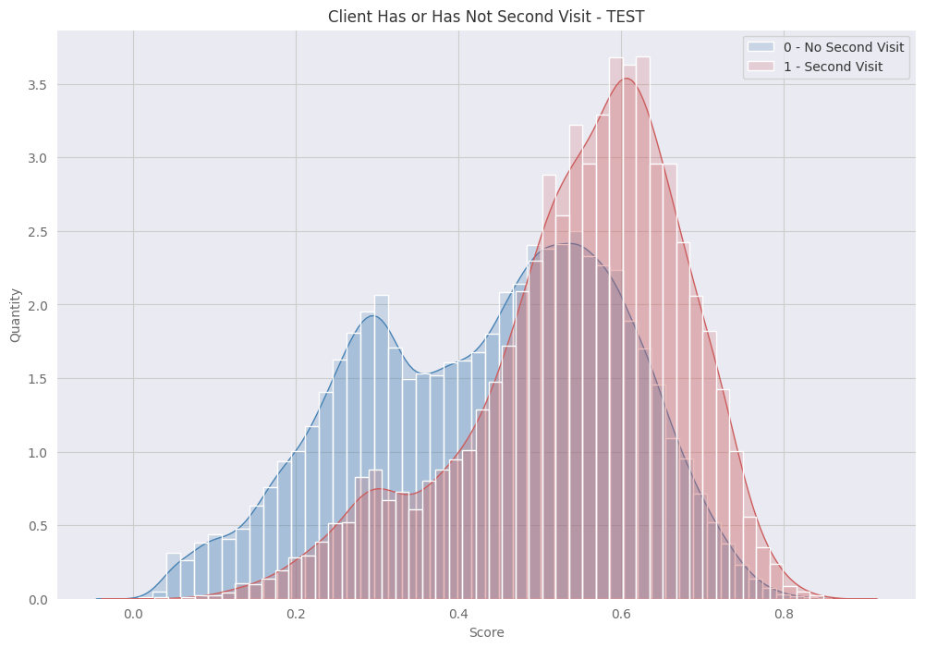
Discrimination Capacity
Despite being the best model at this time, LGBM model for this problem is not as good in discerning classes as it could be.
In this chart on the side, it’s possible to observe that blues and reds are very mixed in the medium score values, what denotes a bad discrimination capacity.
At Lower and higher score values, the discrimination power is slightly bigger, as it becomes easier to the model identifies the correct class.
To improve model performance, one possible strategy is refactoring the model using only the best predictor features. Other possible way is feature engineering to create binary columns rather than expenses in order types feature.

Slide 17
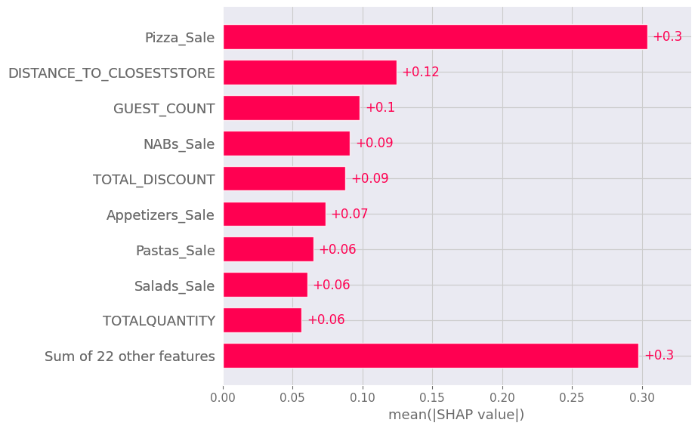
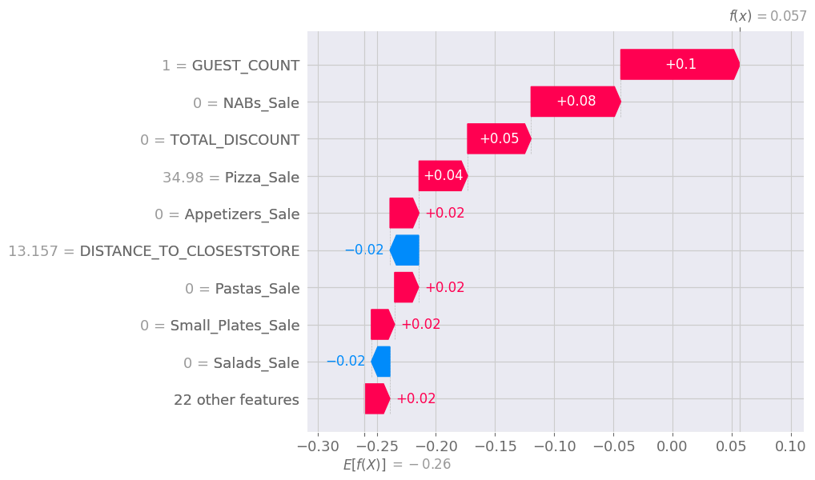
SHAP Values Analysis
It analyses the most contributing features to each class decision in LGBM model.
“Pizza Sales” has the same amount of contribution than the sum of 22 other features.
“Distance to Closest Store” and “Guest Count” are also important features to the model.
In the right chart we can observe that red values contributes more to majority class, while blue values contributes more to discerning the minority class.

Slide 18
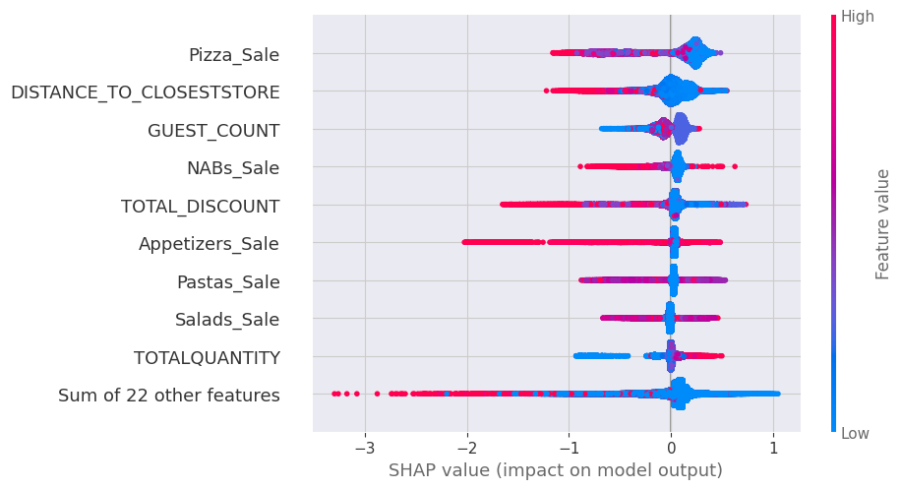
Discrimination capacity
The beeswarm chart also shows a clear view about the importance of these three main features. These chart displays how much each feature can discriminate between the classes in higher or lower probability scores.
For instance, Pizza Sale can discriminate well in lower scores (blue dots on the right) while it is not so good at discriminate higher score values (mixed red and blue dots on the left side of the chart).
With this acquired knowledge, it's possible to build another model using only the most important predictor variables, which can lead to a better classification performance and less computational resources.

Slide 19
The objective of this section is improve the performance of classifier algorithm by adding or removing features from the dataset. There were made several trials and the results are given below:
Select main predictive features based on feature importances and observe if it results in better metrics
Remove less important features from the dataset and analyse the effectiveness of this strategy
Remove excess of features full of zeros (sparsity) and transform dataset in a less sparse informational space using PCA (Principal Component Analysis)
Create a clusterization with K Means to add a new column with group information to the dataset
Try each strategy alone or in addition to the given dataset and evaluate its results
4 - Performance Improvement

Slide 20
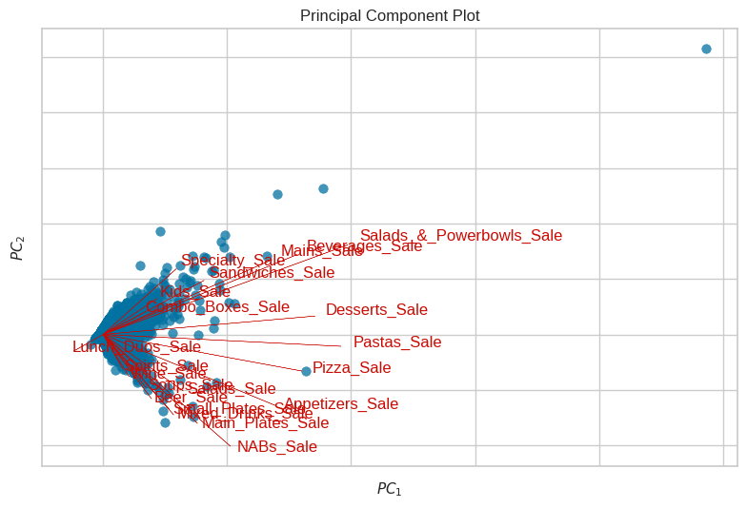
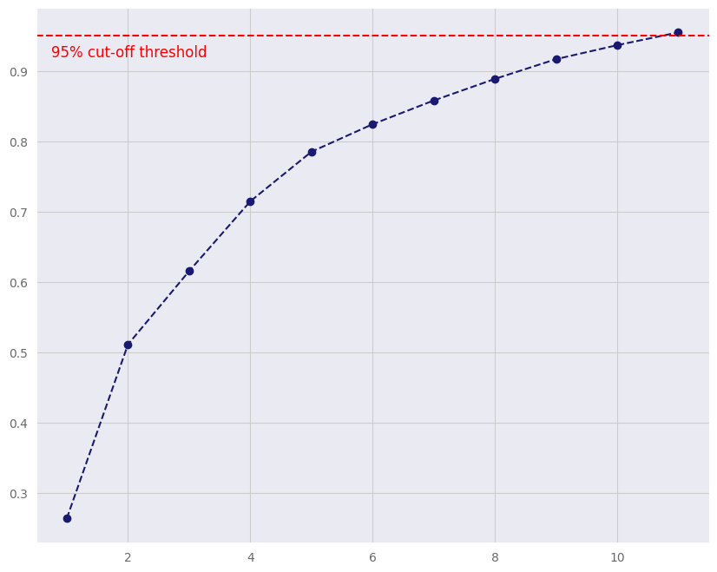
PCA Analysis
PCA was applied to reduce dimensionality in a set of sparse features containing food expenses. This set was full of zeros and has few values, the sparsity of the given set was around 88%, which means that only 12% of the data was really usable. After PCA, the sparsity was reduced to zero and 21 original columns was reduced to 11.
In the above charts it’s possible to notice that:
1 - Data was really concentrated on zeros in the original dataset
2 - the ideal threshold was set to 11 features that can explain 95% of data variability.

Slide 21
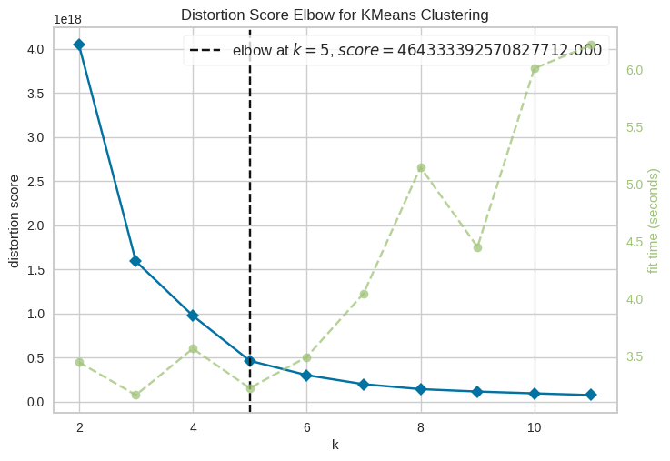
Clustering with K Means
K Means is an unsupervised clustering algorithm which tries to separate groups based on the distance between each data entries.
It is a feature engineering strategy to add useful labeled information to the dataset.
This chart shows the Elbow Curve, indicating the best number of clusters to be added to the data. It indicates that 5 is the optimal K cluster. Grouping the data in 5 groups leads to minimum run time with the maximum information gain.
The cluster information was added to a new column in the given dataset and a new model was trained with this configuration.

Slide 22
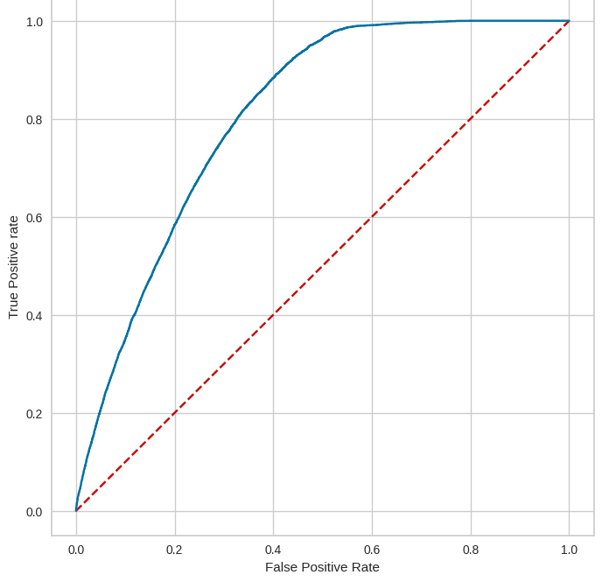
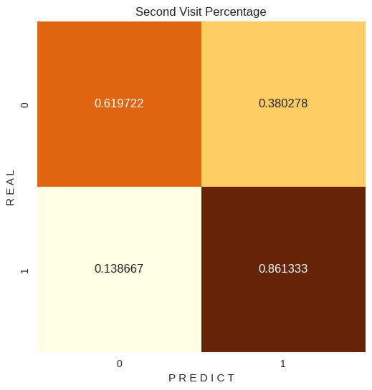
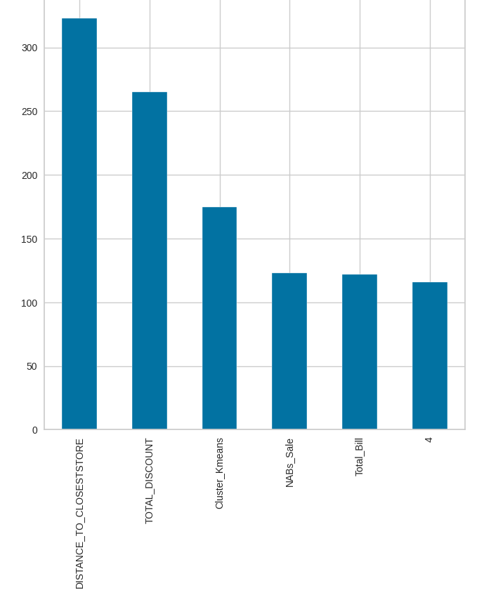
Results of LGBM After Optimization
ROC AUC Curve improves from 70% score to 80% score after PCA and K Means clustering.
Confusion matrix has better values, false negative is now 14% and true negative is 86%, while true positive is 62% and false positive is 38%.
Cluster K Means turns to be the third most important predictor feature, indicating the prediction power of this new feature.

Slide 23
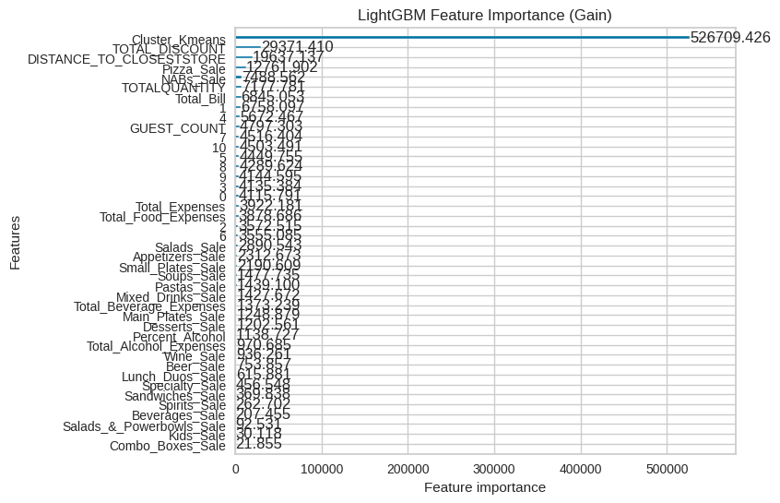
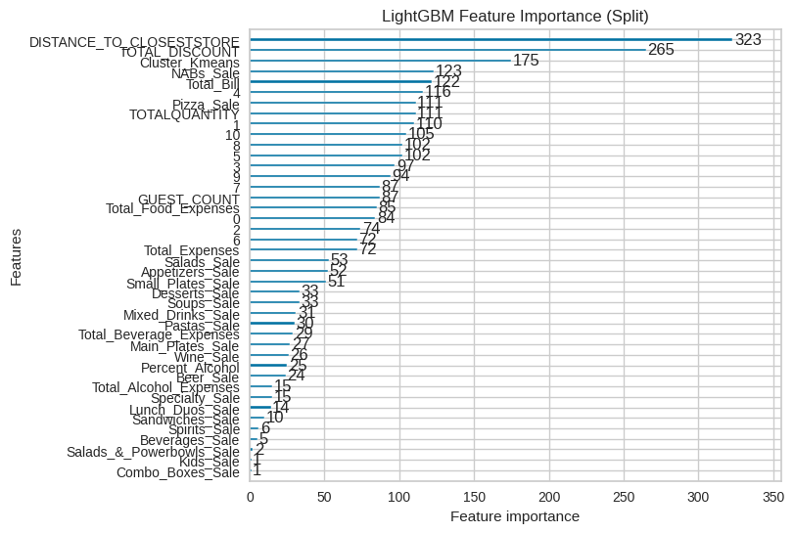
LGBM Gain and Split Feature Importances
In terms of Gain, that is, how much predictor power was added with the presence of a feature, K means it’s by far the most important addition to the model.
In terms of Split, in other words, the capability of divide the data points within trees, Distance to Closest Store was considered the most important feature in the decision making process.

Slide 24
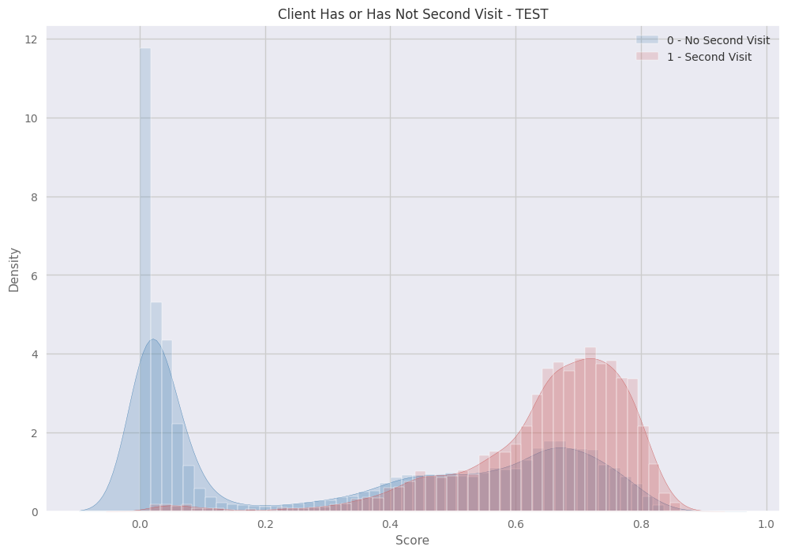
Discrimination Capacity
When compared to previous model, this time it’s noticeable that the optimized model has a better capability in discerning the different classes.
The overlap between classes has become smaller, thus because the model is more accurate and with a better recall.
The chart shows distinct classes in a clear way than previous chart. The classes are much more separated in low and high scores, with an overlap in the middle scores.

Slide 25
This dataset has presented some challenges and several strategies and trials were conducted to improve classifier performance and it’s reliability. There were made some feature engineering using the existent information.
There was a large set of columns with little sparse data (many zeros and little values), this sparsity needs to be analysed in order to acquire better performance. PCA was applied over this subset to increase prediction power derived from this info and it leads to some information gain. But also, a non-supervised Machine Learning model was applied (K Means clustering) to give new information to model.
Some of the most important features to determine the customer behaviors are Distance, Guest Count and some kind of food expenses, related to Pizza, Pasta and Salads sales. After the clusterization, the cluster group becomes the most important decision making feature and this strategy increases in 10% the effectiveness of the model.
Total Discount was also a great predictor feature and alcoholic beverages was low related to returning customers. To acquire more returning customers, this research model can help understanding which kind of behaviors and strategies has larger probability of effectiveness in the business conduction.
5 - Conclusions / Insights

Slide 26
Thanks for the opportunity! Hope you enjoyed the analysis!

